Slide 1

Inventory Management System (IMS)
By Tasnima Monaf

Slide 2
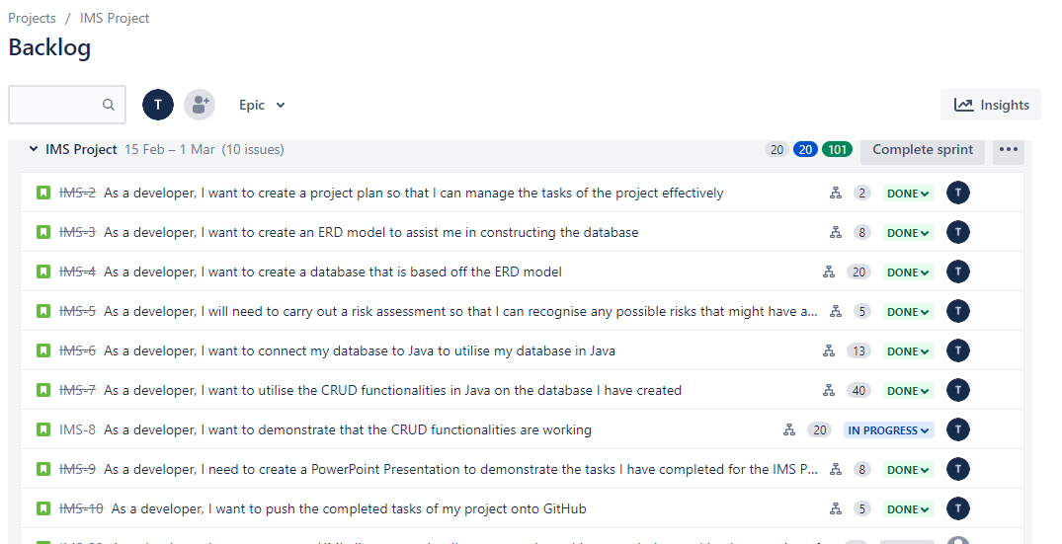
Introduction
I approached the specification by creating a plan using Jira Board
Epic
User Stories
Child Issues
Allocated a score for the level of effort required for each user story

Slide 3
Consultant Journey
The technologies that I have learnt for this project were:
Jira Board (Kanban board)
Git (Version Control System)
GitHub (Source Code Management)
MySQL (Database Management System)
Java (Back-End Programming Language)
Maven (Build tool)
Junit (testing)

Slide 4
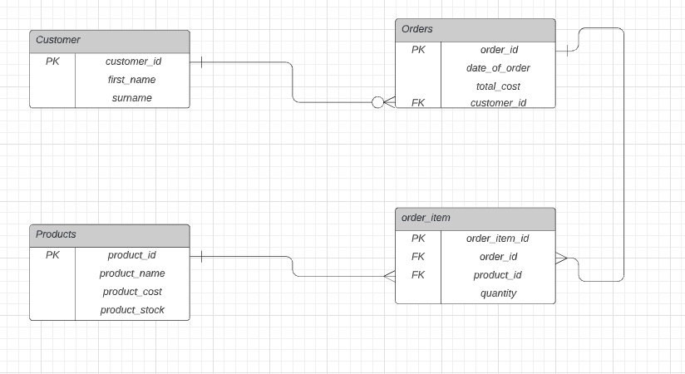
ERD Model

Slide 5
CI – Version Control (Git)
Used git-checkout to switch to the dev branch from the main branch
Within the dev branch, I created a feature branch using ‘git checkout –b’
After completing the project, I merged the feature branch to the dev branch
Created a pull request

Slide 6
Testing and Demonstration
I will now run through a demonstration of the testing

Slide 7

Sprint review + retrospective
I experienced issues with my testing
I wanted to implement a “getDate” method but wasn’t able to implement it correctly and faced errors in my code

Slide 8
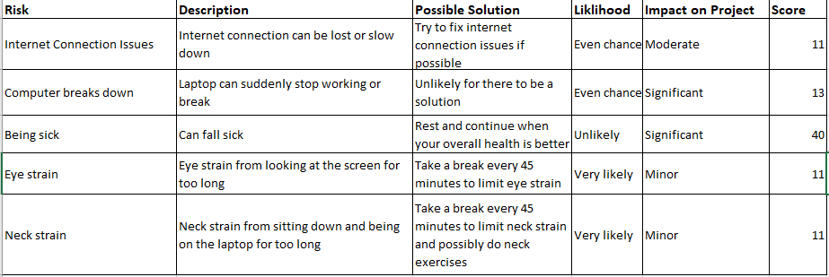
Risk Assessment

Slide 9
Conclusion
Improve the testing
Time management

